Slide 1
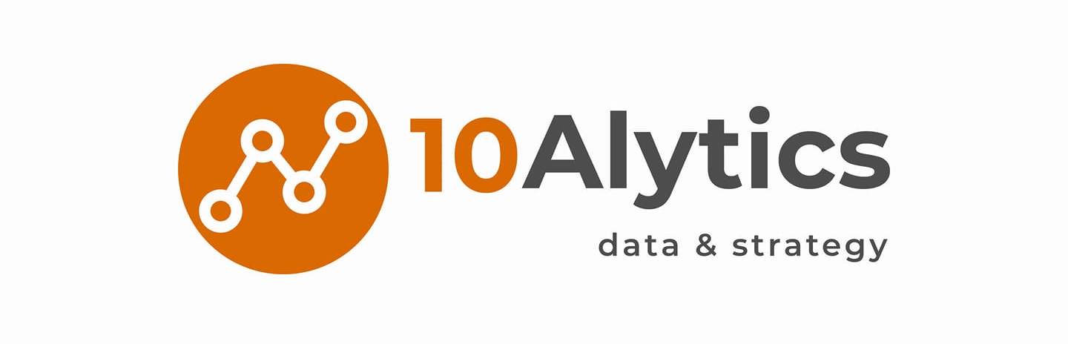
Using Data Modelling for Predicting Bank Direct Marketing Outcome
- Abidemi Lemboye

Slide 2
Introduction
Banks host a large repository of their customers data, which could be used in directing targeted marketing campaigns to selected customers via personal contact, emails, and telephone calls. The immediate option of getting a direct feedback immediately from the customers makes this direct marketing campaigns a popular choice for many financial institutions.
This project is to predict the outcome of the direct marketing campaign of a Portuguese banking institution by building and testing different machine learning models.
This dataset used is publicly available for research. The details are described in [Moro et al., 2011].
[Moro et al., 2011] S. Moro, R. Laureano and P. Cortez. Using Data Mining for Bank Direct Marketing: An Application of the CRISP-DM Methodology.
In P. Novais et al. (Eds.), Proceedings of the European Simulation and Modelling Conference - ESM'2011, pp. 117-121, Guimarães, Portugal, October 2011. EUROSIS.
Available at: [pdf] http://hdl.handle.net/1822/14838
[bib] http://www3.dsi.uminho.pt/pcortez/bib/2011-esm-1.tx

Slide 3
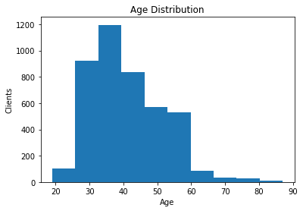
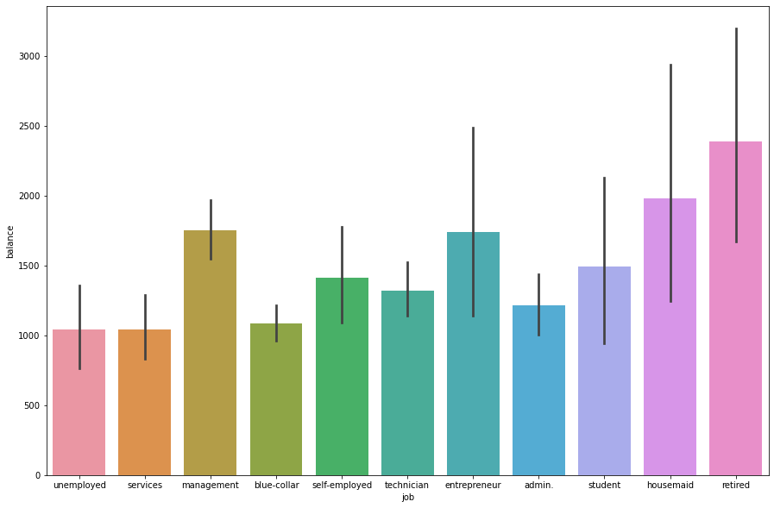
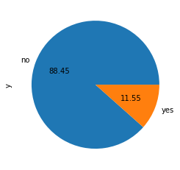
Exploratory Data Analysis
Average yearly balance in euros for the customers was 1,410 euros
with Retirees having the highest balance
4,311
Customers
Class imbalance in the target column ‘y’

Slide 4
Model Evaluation
Four models were trained using the data set. The models were evaluated using the Classification metrics (Accuracy, Precision & Recall).
Of the four models, Random Classifier produced the best metrics with an Accuracy of 0.97, Precision of 0.94 & Recall of 0.99
Confusion matrix showing 735 True Positives and 738 True negatives for the Random Classifier Model

